Slide 1
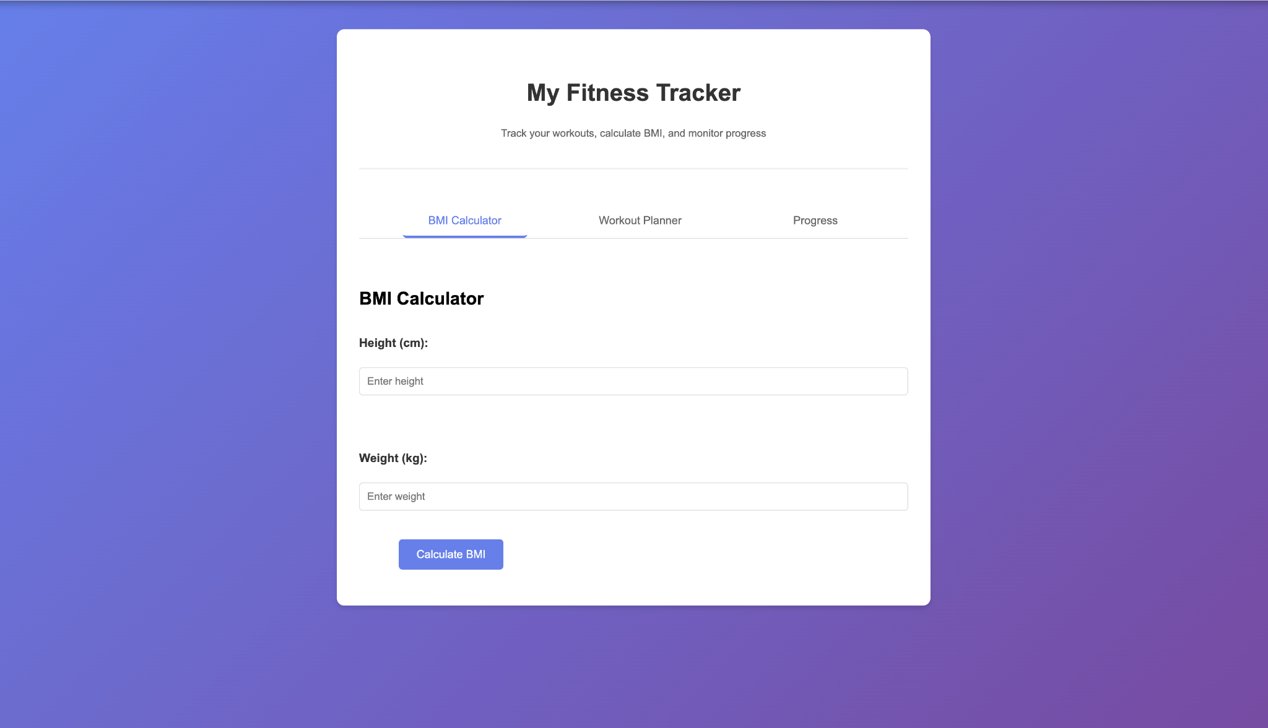
Fitness Tracker UI
This project is a web application built using HTML, CSS and JavaScript.
In this fitness tracker website, you can check your BMI (Body Mass Index) using your Height and Weight!

Slide 2
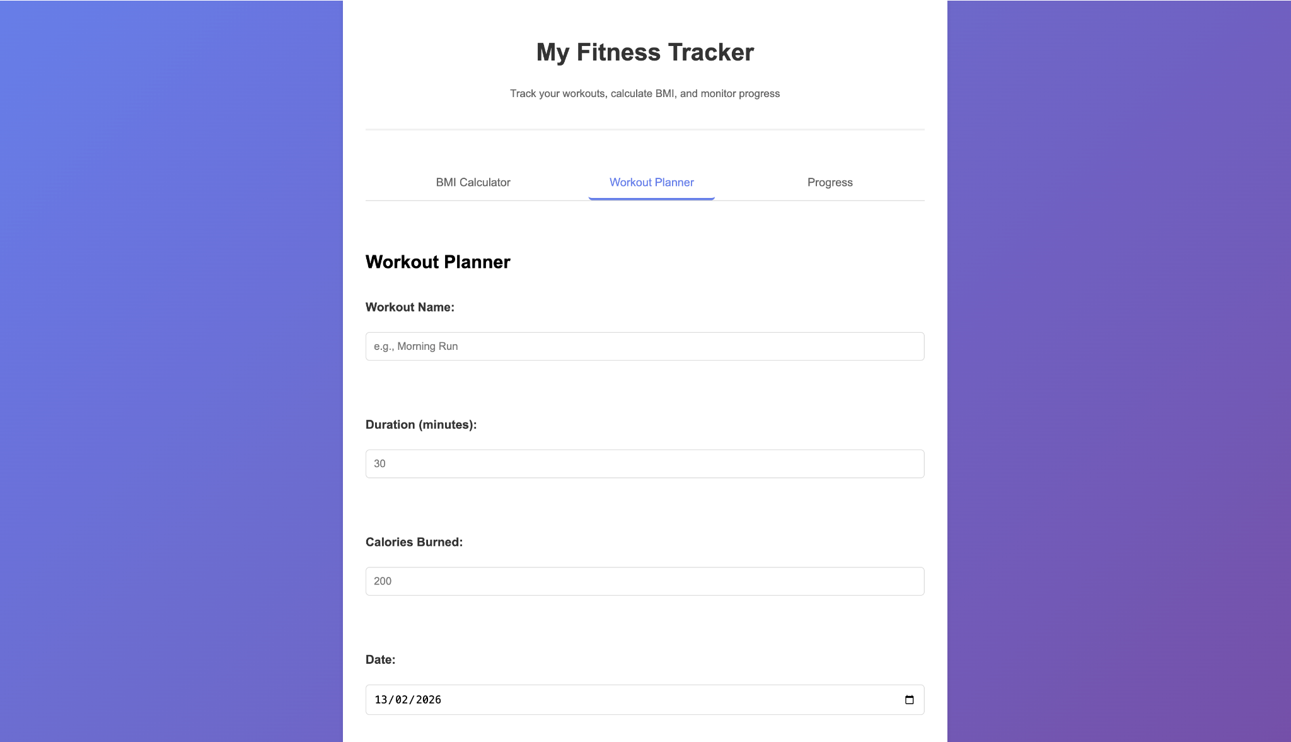
BMI Calculator Section
HTML creates inputs. CSS styles layout.
JavaScript calculates BMI dynamically.
We can say the workout name with it’s duration we want to perform it for and it will estimate the calories burned with the help of the date so we can track it per day.

Slide 3
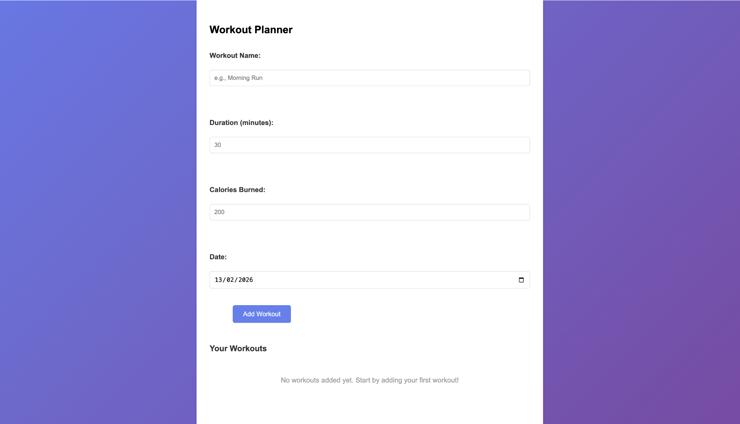
Workout Planner
Form collects workout details. CSS styles fields.
JS stores workouts.

Slide 4
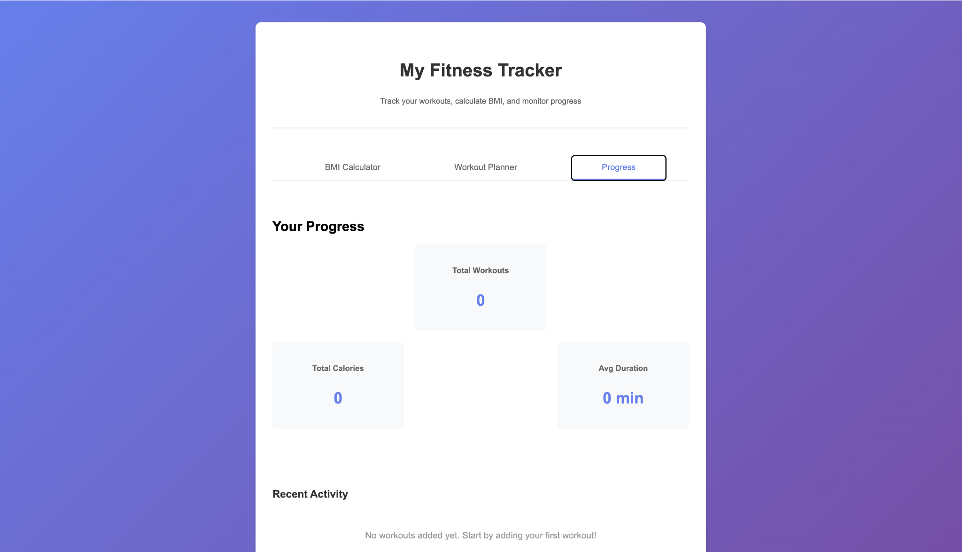
Workout Display
Entered workouts appear instantly.
JavaScript updates UI dynamically.
Here, we can check our average daily activity and it’s average.

Slide 5
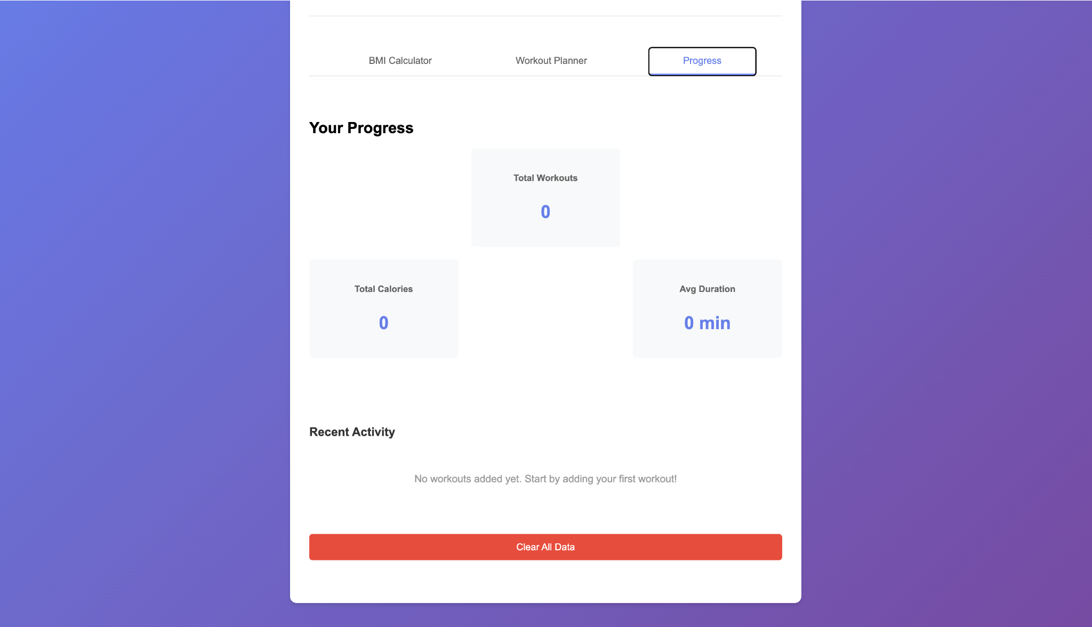
Progress Dashboard
Statistics update automatically using JavaScript calculations.
It shows the recent activity which we have done and we can clear all the data too!

